Slide 1
Scientific Method

Slide 2

In this Smart Lesson we will cover the following points:
Outline the steps of the scientific method.
Describe why scientists write scientific reports.

Slide 3
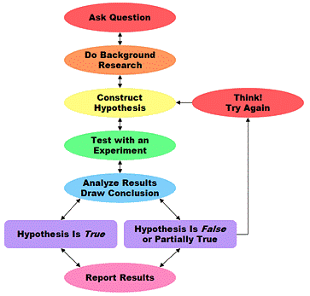
The scientific method is the method that is used to carry out scientific experiments.
It is the way scientists ask and answer scientific questions by making observations and doing experiments. The image below shows the steps of the scientific method.

Slide 4
The steps of the scientific method are:
1. | Ask a question.
2. | Do some background research to determine the best way to do your experiment, or to make sure it has not been done before.
3. | Construct a hypothesis for your experiment.
4. | Test your hypothesis with an experiment.
5. | Analyse the data from the experiment to see if it supports your hypothesis, and draw a conclusion. If the hypothesis is not supported, you can go back to step 3 and conduct a new experiment to test your idea.
6. | Communicate your results by writing a scientific report.

Slide 5

After a scientist conducts an investigation, they write a scientific report to communicate the results of their experiment to other people.

Slide 6

A scientific report should always include the following sections:
• | Aim
• | Hypothesis
• | Materials
• | Method
• | Results and Observations
• | Discussion
• | Conclusion

Slide 7

Let's begin with the aim, as all experiments do.
The aim is a statement about the purpose of the experiment.
It always begins with ‘To’.
For example: To investigate the time taken for water to boil.

Slide 8

A hypothesis is your best educated guess of what you think you will discover.
It can be written in this format:
Hypothesis:
If the (dependent variable) is related to (independent variable), then (prediction). This is because (explanation).

Slide 9
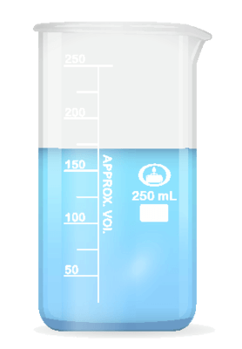
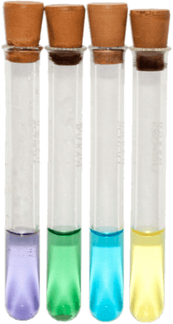
The materials section of a scientific report is a list of the equipment and chemicals that were used.
Water is not included in this.

Slide 10

The method section of a scientific report is an account of what was done.
This will usually include a diagram showing how the equipment was set up. There should be enough detail to allow the reader to repeat the experiment.
It should also always be written in past tense passive voice.
For example: The sodium chloride solution was added to the copper sulfate solution.

Slide 11
The results and observations section of a scientific report is a presentation of your data.
This can include lists of observations and calculations of tables and graphs.

Slide 12

The discussion section of a scientific report is an explanation of the results and a description of any difficulties that may have occurred during the experiment.
This might also include suggestions for improvements and modifications to the experiment.

Slide 13

The conclusion section of a scientific report is a brief account of the results of the experiment and a description of how the findings relate to the aim.
It is a good idea to read your aim again before you write your conclusion.

